Slide 1
Co–Location App LaRavel
Made by : A. Dehbi
Assigned by : MR H. Mouncif

Slide 2
AXES :
Application functionalities.
External Packages.
User Interfaces.

Slide 3
1- Application functionalities :
By using this application, the user can:
Register his account.
Sign IN.
Create new Offers.
Create new Requests.
Delete his own offers.
Delete his own Request.
Visualize all offers and their details.
Visualize all Requests and their details.
Visualize all offers on a map using markers.
Visualize all offers details on the map by clicking on the marker.

Slide 4
2- External Packages :
Packages | Usage
Laravel auth | To Manage the user Authentication and registration.
Leafleat | To integrate an open source library for map and markers.
Google geocoder Api | To make forward and reverse geocoding

Slide 5
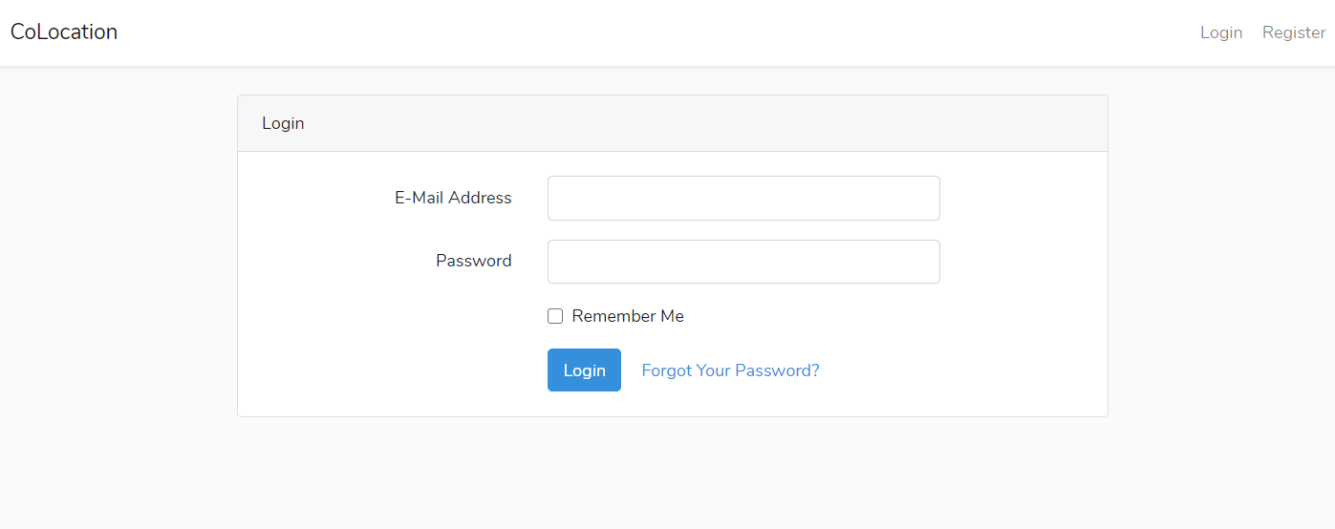
3- User Interfaces:
Login Interface

Slide 6
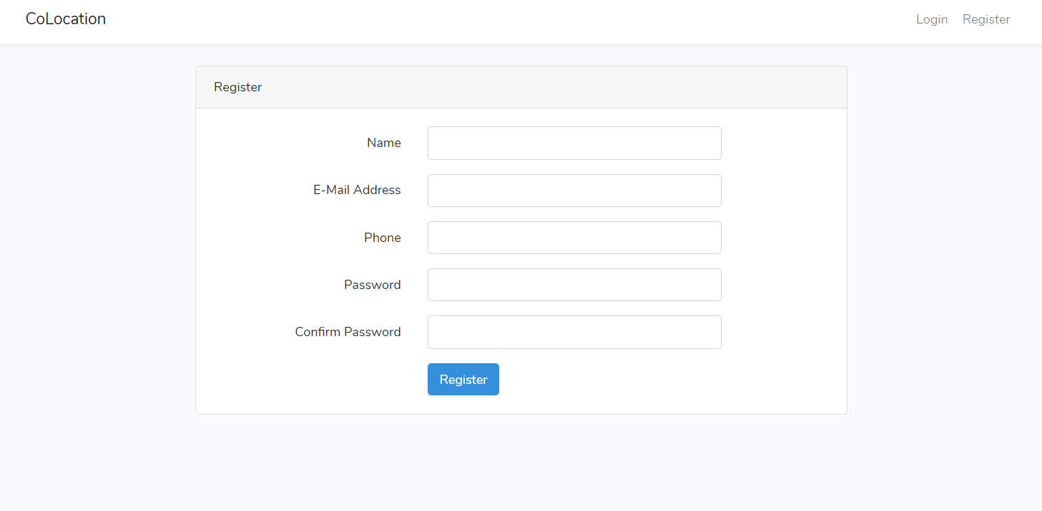
3- User Interfaces:
Registration Interface

Slide 7
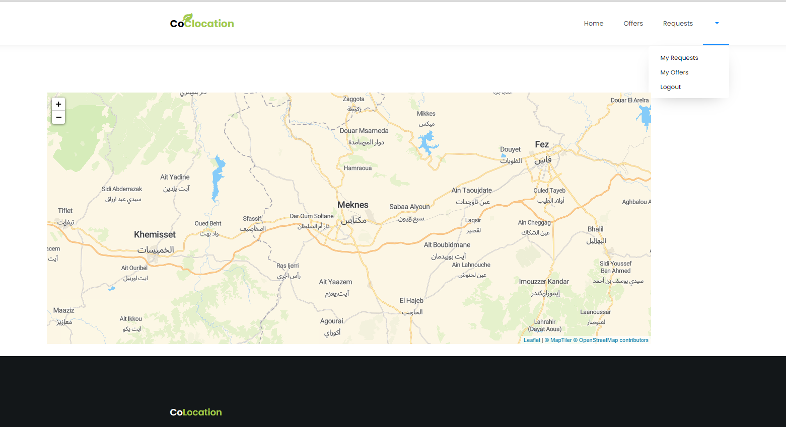
3- User Interfaces:
Home Page
To locate offers on the map, I need google API key for geocoding t go get coordinates from addresses.
To get the API key, I have to provide my credit cart number. I have Implemented the code but my requests are not authorized since I don’t have the API key.

Slide 8
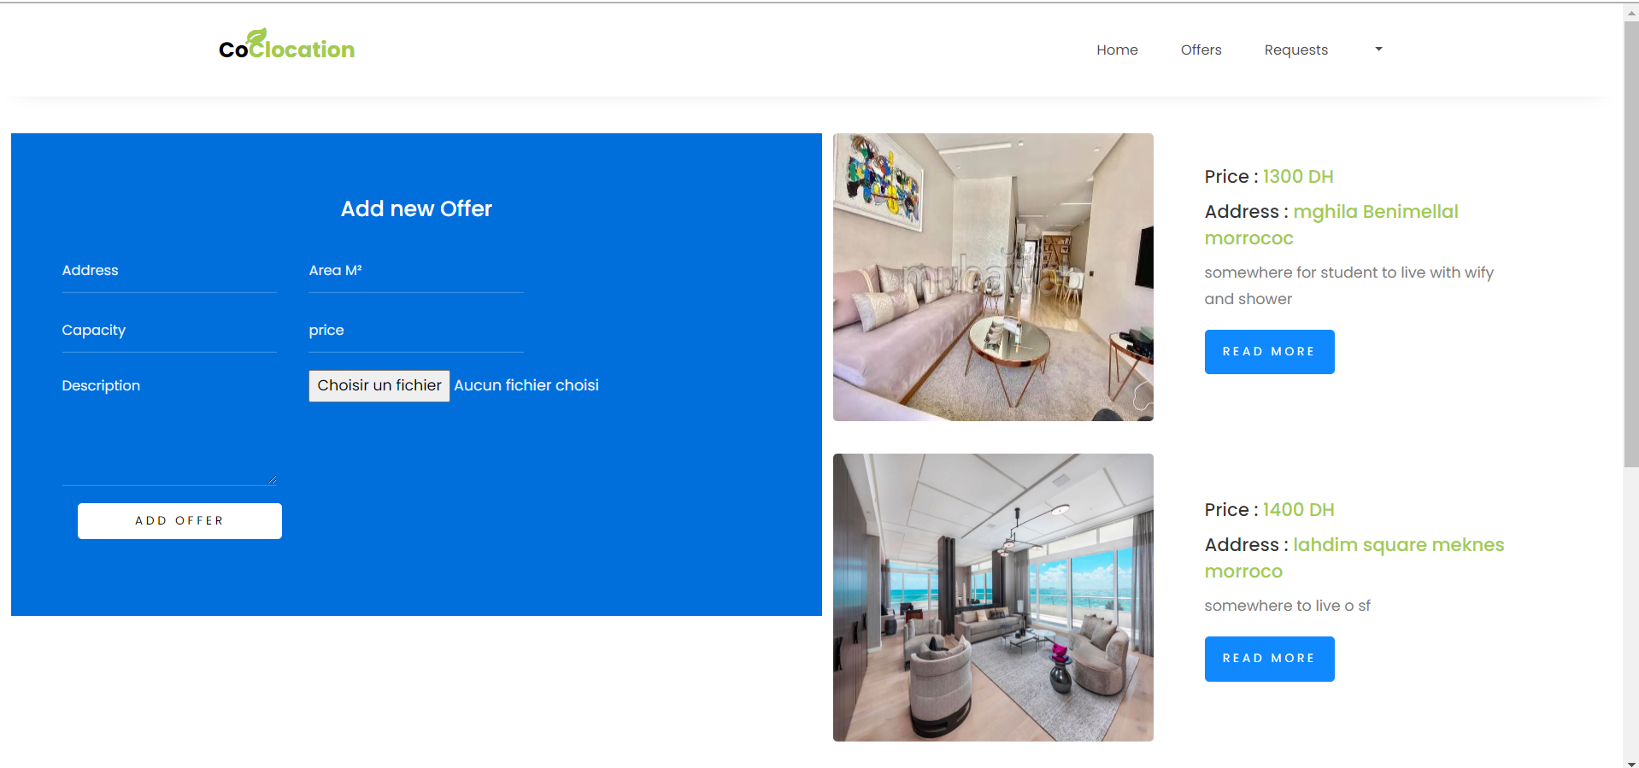
3- User Interfaces:
Offers Page

Slide 9
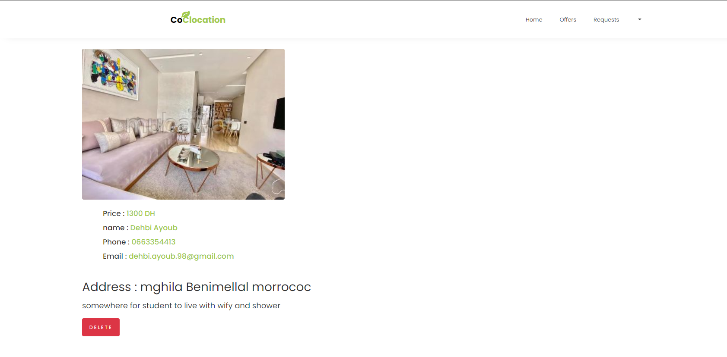
3- User Interfaces:
Offers Details page
The delete button appears if its the User offer

Slide 10
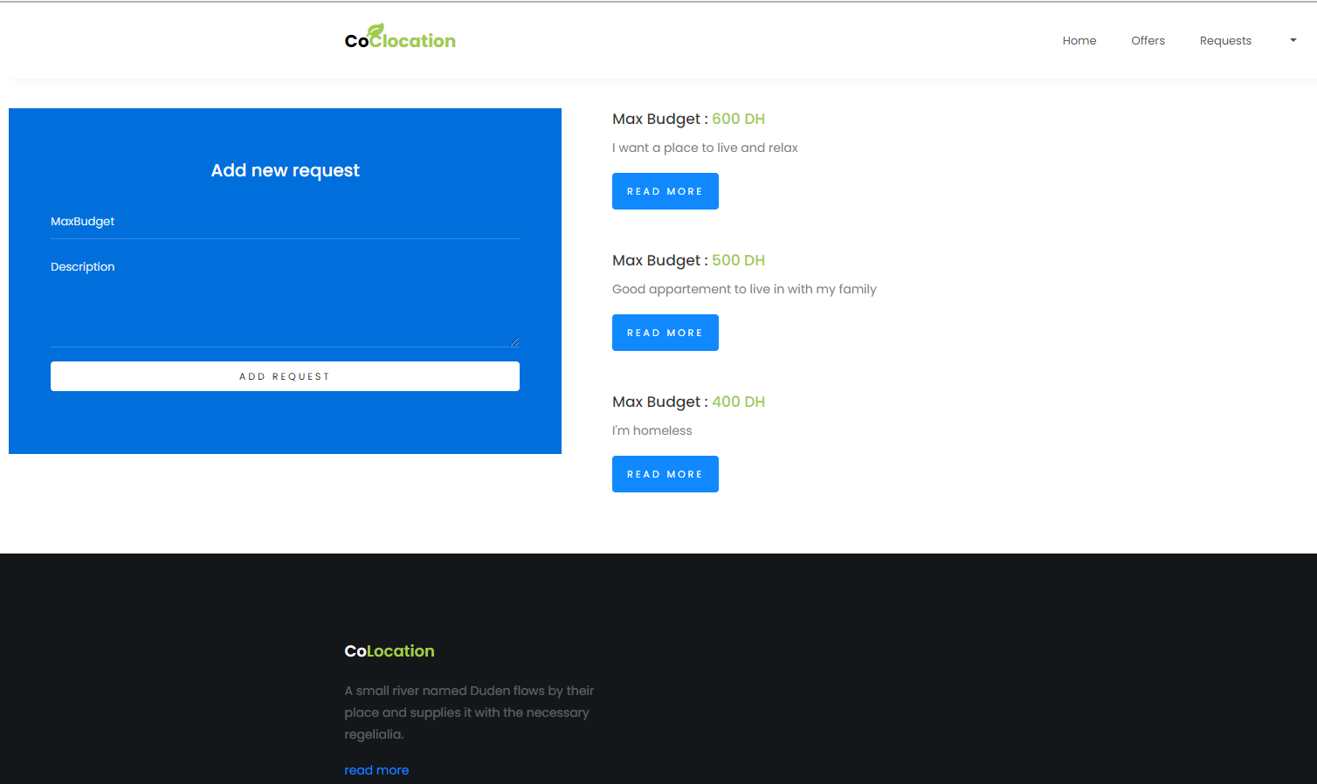
3- User Interfaces:
Requests Page

Slide 11
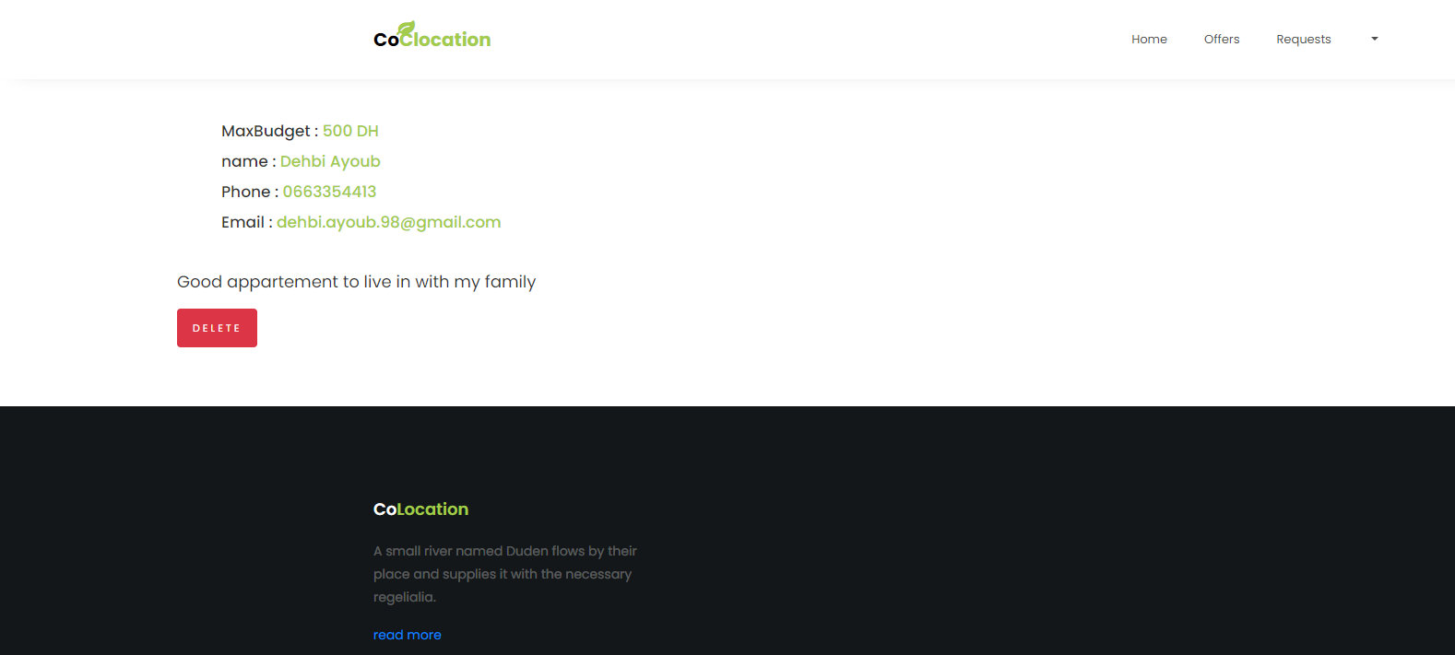
3- User Interfaces:
Request details page
The delete button appears if its the User request

Slide 12
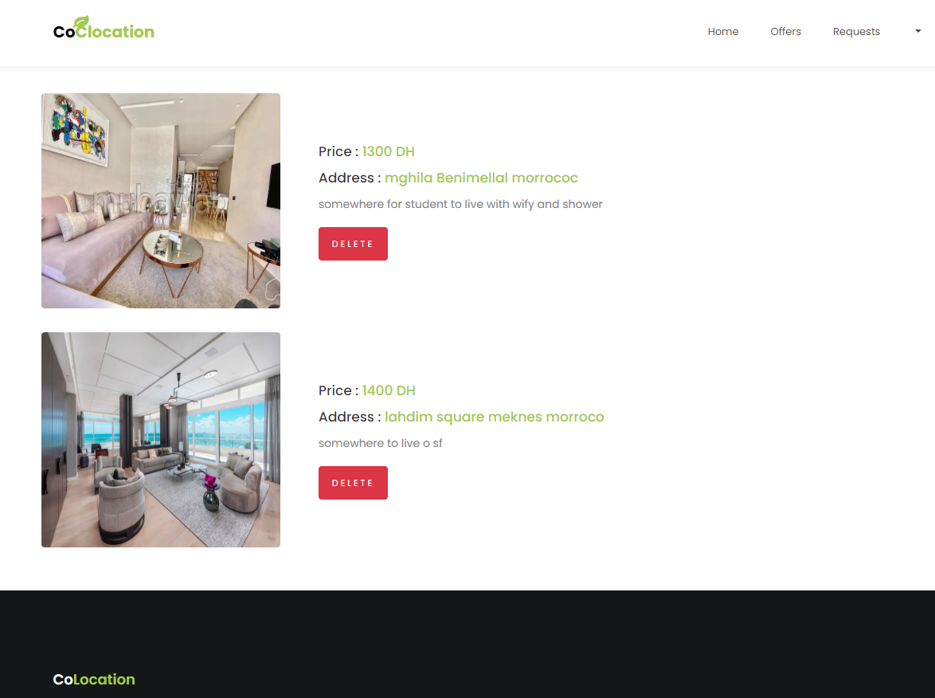
3- User Interfaces:
User’s offers page

Slide 13
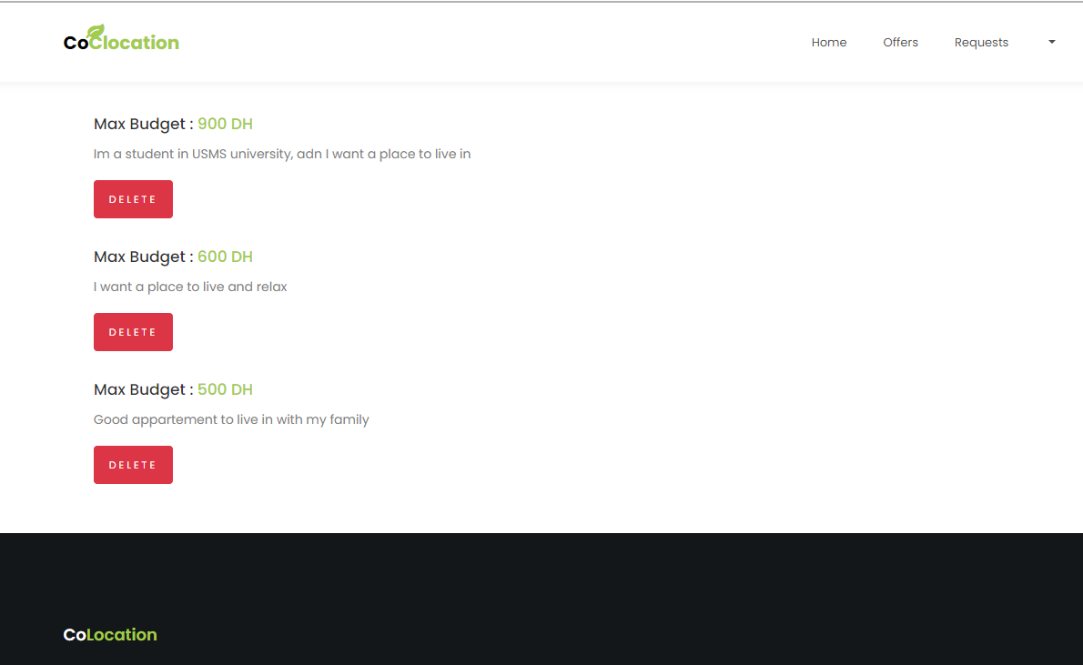
3- User Interfaces:
The user’s Requests page

Slide 14
References:
https://laravel.com/docs/7.x/eloquent#collections
https://opencagedata.com/tutorials/geocode-in-javascript
https://www.youtube.com/watch?v=vmHHj3lBwGg
https://stackoverflow.com/questions/25581591/javascript-retrieve-data-from-db
https://stackoverflow.com/questions/35451450/how-to-fetch-data-from-mysql-database-in-javascript-to-build-a-chart
https://colorlib.com/preview/#healthcoach
https://leafletjs.com/download.html
https://cloud.maptiler.com/maps/streets/
GitHub : https://github.com/KitayDehbi/Colocation_Laravel_App

